Slide 1
Course : Calculus I
Effective Period : 2023
Advanced Derivative Session 7 - 9

Slide 2
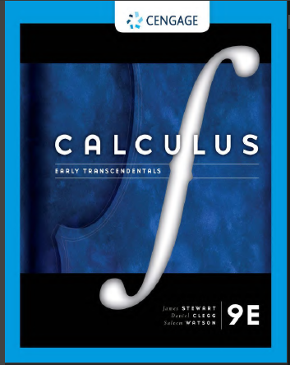
These slides have been adapted from: Stewart, J. D. Clegg, S. Watson (2020). Calculus Early Transcendentals, 9, USA, Cengage Learning, Inc, 2020. ISBN: 978-1337613927
Acknowledgement

Slide 3

Learning Objectives
LO 2:
Explain the properties of derivative to describe geometric and physical problems, and other applications.

Slide 4
Content
1
Implicit Differentiation
2
Derivatives of Logarithmic and Inverse Trigonometric Functions
3
Rates of Change in the Natural and Social Sciences
4
Related Rates
5
Hyperbolic Functions

Slide 5
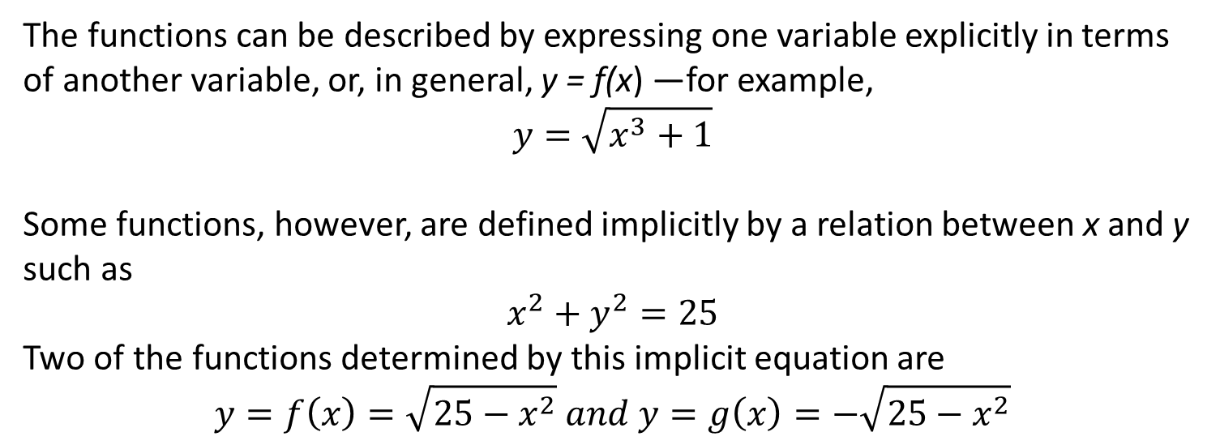
Explicitly Defined Functions
The functions can be described by expressing one variable explicitly in terms of another variable, or, in general, y = f(x) —for example,
$$y=\sqrt{x^{3}+1}$$
Some functions, however, are defined implicitly by a relation between x and y such as
$$x^{2}+y^{2}=25$$
Two of the functions determined by this implicit equation are
$$y=f\left(x\right)=\sqrt{25−x^{2}} and y=g\left(x\right)=−\sqrt{25−x^{2}}$$

Slide 6
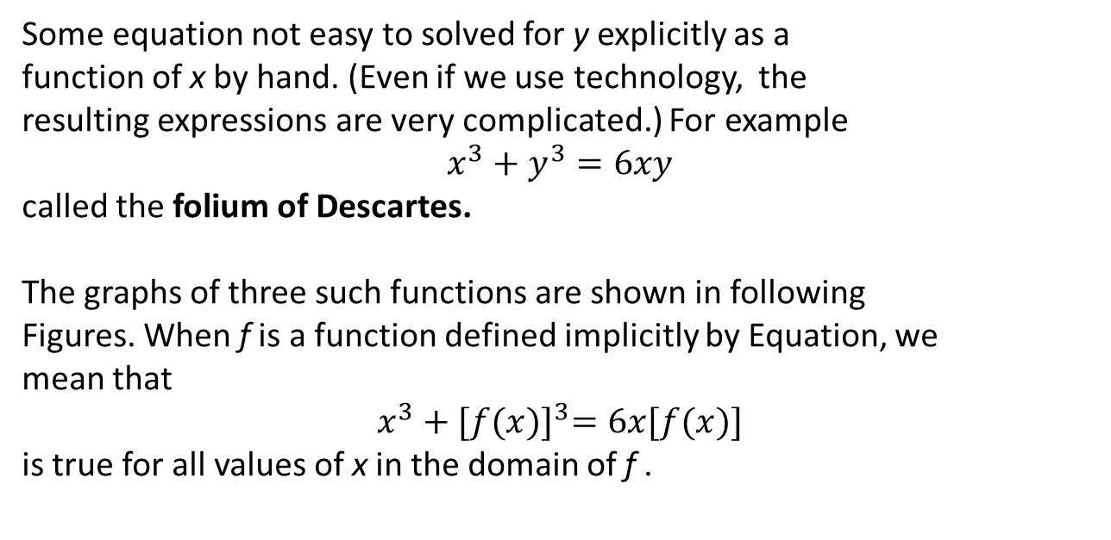
Implicitly Defined Functions
Some equation not easy to solved for y explicitly as a
function of x by hand. (Even if we use technology, the
resulting expressions are very complicated.) For example
$$x^{3}+y^{3}=6xy$$
called the folium of Descartes.
The graphs of three such functions are shown in following
Figures. When f is a function defined implicitly by Equation, we
mean that
$$x^{3}+{[f(x)]}^{3}=6x[f(x)]$$
is true for all values of x in the domain of f .

Slide 7
Implicit Differentiation Method
Suppose that a function y = f(x) is defined implicitly via an equation in x and y. To compute dy/dx:
Differentiate both sides of the equation with respect to x. Make sure that the derivative of any term involving y includes the factor dy/dx.
1
2
Solve the resulting equation for dy/dx in terms of x and y.

Slide 8
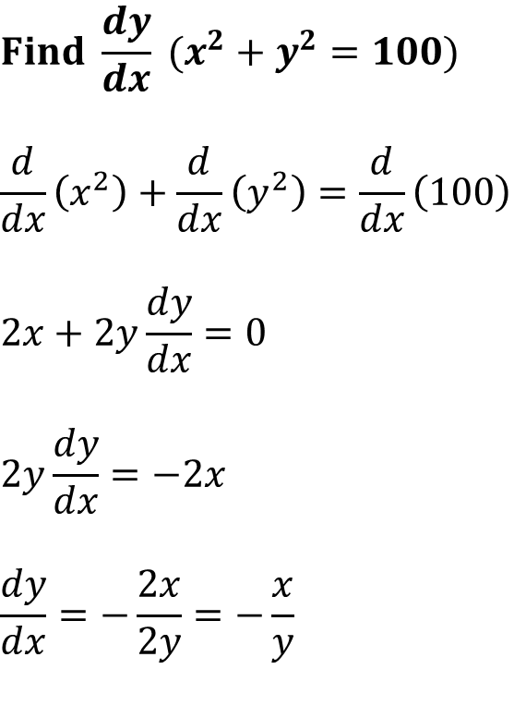
$${Find \frac{dy}{dx} (x}^{2}+y^{2}=100)$$
$$\frac{d}{dx}\left(x^{2}\right)+\frac{d}{dx}\left(y^{2}\right)=\frac{d}{dx}\left(100\right)$$
$$2x+2y\frac{dy}{dx}=0$$
$$2y\frac{dy}{dx}=−2x$$
$$\frac{dy}{dx}=−\frac{2x}{2y}=−\frac{x}{y}$$

Slide 9
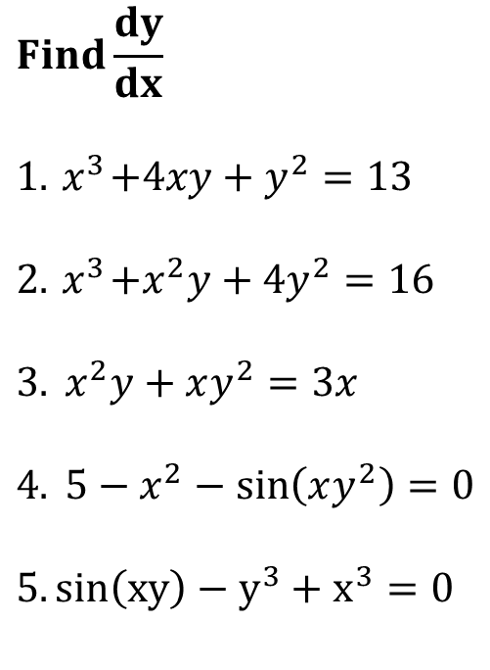
$$Find\frac{dy}{dx}$$
$$1. { x}^{3}+4xy+y^{2}=13$$
$$2. { x}^{3}+x^{2}y+4y^{2}=16$$
$$3. { x}^{2}y+xy^{2}=3x$$
$$4. 5−x^{2}−\sin\left(xy^{2}\right)=0$$
$$5. sin\left(xy\right)−y^{3}+x^{3}=0$$

Slide 10
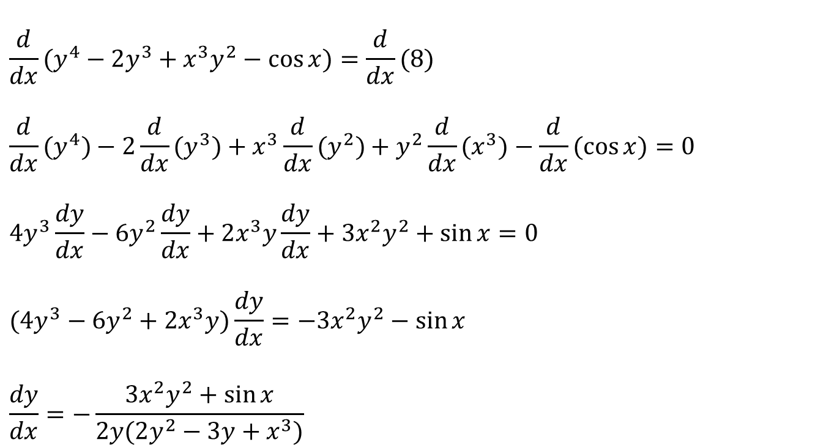
Example 1
If y⁴ – 2y³ +x³y² – cos x = 8 then
$$\frac{d}{dx}(y^{4}−2y^{3}+x^{3}y^{2}−\cos{x})=\frac{d}{dx}(8) \\ \frac{d}{dx}(y^{4})−2\frac{d}{dx}(y^{3})+x^{3}\frac{d}{dx}(y^{2})+y^{2}\frac{d}{dx}(x^{3})−\frac{d}{dx}(\cos{x})=0 \\ 4y^{3}\frac{dy}{dx}−6y^{2}\frac{dy}{dx}+2x^{3}y\frac{dy}{dx}+3x^{2}y^{2}+\sin{x}=0 \\ (4y^{3}−6y^{2}+2x^{3}y)\frac{dy}{dx}=−3x^{2}y^{2}−\sin{x} \\ \frac{dy}{dx}=−\frac{3x^{2}y^{2}+\sin{x}}{2y(2y^{2}−3y+x^{3})}$$

Slide 11
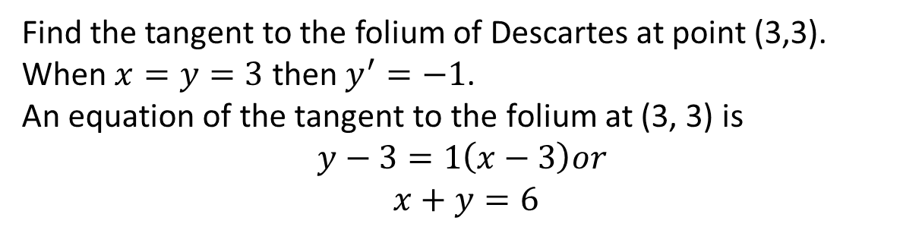
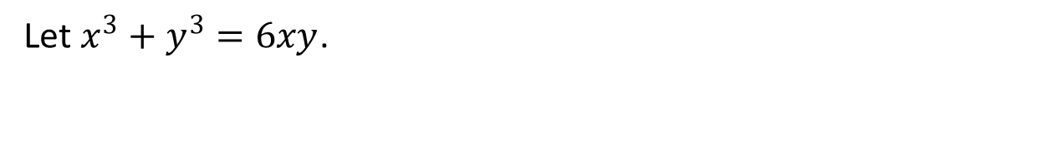
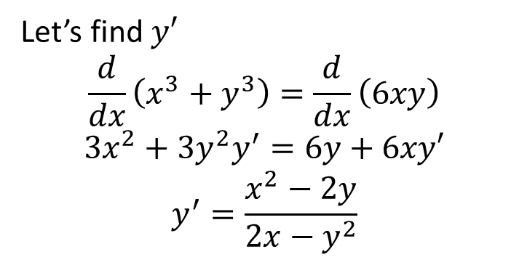
Example 2 (1/2)
Let $x^{3}+y^{3}=6xy$.
Let’s find $y′$
$$\frac{d}{dx}\left(x^{3}+y^{3}\right)=\frac{d}{dx}\left(6xy\right)$$
$$3x^{2}+3y^{2}y^{′}=6y+6xy′$$
$$y^{′}=\frac{x^{2}−2y}{2x−y^{2}}$$
Find the tangent to the folium of Descartes at point (3,3).
When $x=y=3$ then $y^{′}=−1\text{.}$
A$\text{n} \text{equation} \text{of} \text{the} \text{tangent} \text{to} \text{the} \text{folium} \text{at}\text{ (3, 3) }\text{is}$
$$y−3=1\left(x−3\right)or$$
$$x+y=6$$

Slide 12
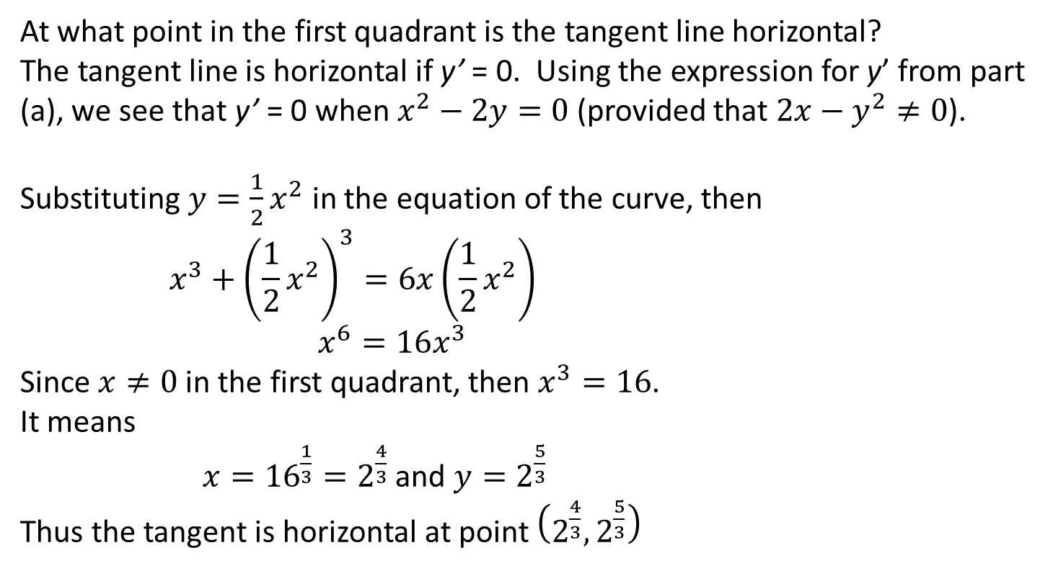
Example 2 (2/2)
At what point in the first quadrant is the tangent line horizontal?
The tangent line is horizontal if y’ = 0. Using the expression for y’ from part (a), we see that y’ = 0 when $x^{2}−2y=0$ (provided that $2x−y^{2}≠0$).
Substituting $y=\frac{1}{2}x^{2}$ in the equation of the curve, then
$$x^{3}+{\left(\frac{1}{2}x^{2}\right)}^{3}=6x\left(\frac{1}{2}x^{2}\right)$$
$$x^{6}=16x^{3}$$
Since $x≠0$ in the first quadrant, then $x^{3}=16$.
It means
$x={16}^{\frac{1}{3}}=2^{\frac{4}{3}}$ and $y=2^{\frac{5}{3}}$
Thus the tangent is horizontal at point $\left(2^{\frac{4}{3}}, 2^{\frac{5}{3}}\right)$

Slide 13
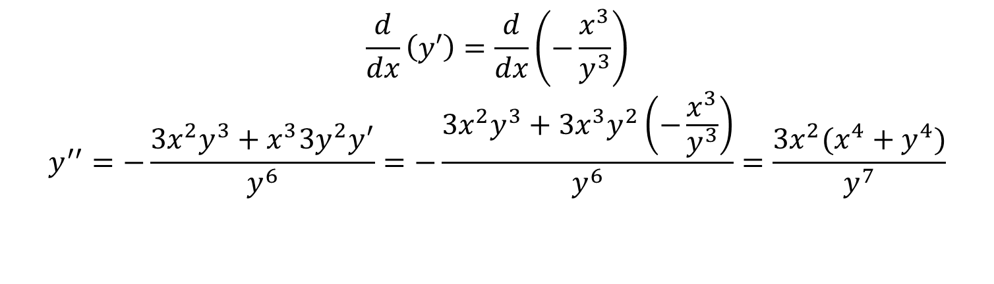
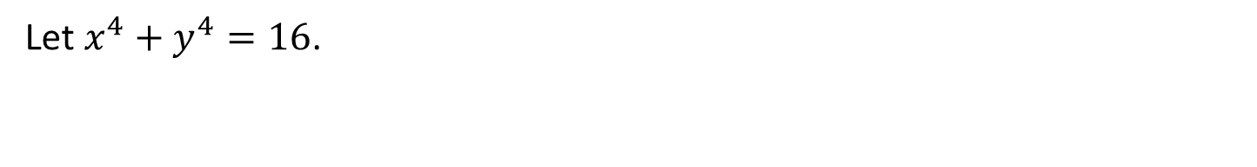
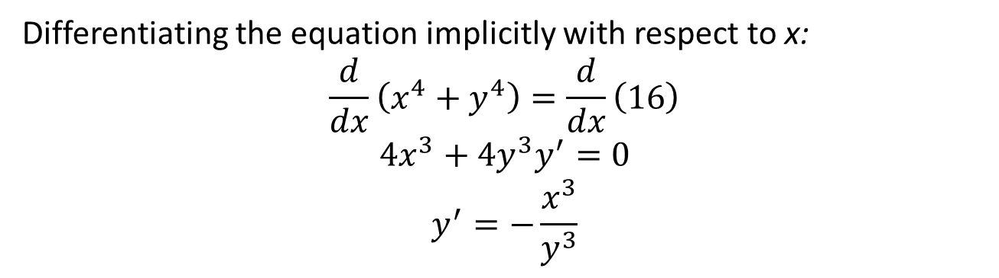
Example: Second Derivatives of Implicit Functions
Let $x^{4}+y^{4}=16$.
Differentiating the equation implicitly with respect to x:
$$\frac{d}{dx}\left(x^{4}+y^{4}\right)=\frac{d}{dx}\left(16\right)$$
$$4x^{3}+4y^{3}y^{′}=0$$
$$y^{′}=−\frac{x^{3}}{y^{3}}$$
$$\frac{d}{dx}\left(y′\right)=\frac{d}{dx}\left(−\frac{x^{3}}{y^{3}}\right)$$
$$y^{′′}=−\frac{3x^{2}y^{3}+x^{3}3y^{2}y^{′}}{y^{6}}=−\frac{3x^{2}y^{3}+3x^{3}y^{2}\left(−\frac{x^{3}}{y^{3}}\right)}{y^{6}}=\frac{3x^{2}(x^{4}+y^{4})}{y^{7}}$$

Slide 14
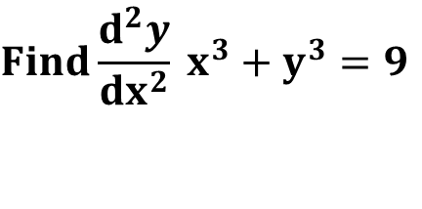
$$Find\frac{d^{2}y}{dx^{2}} x^{3}+y^{3}=9$$

Slide 16
Derivatives of Logarithmic Functions
Logarithmic
Functions

Slide 17
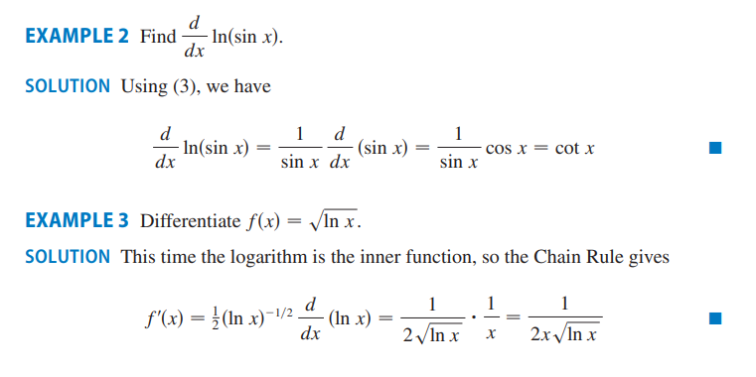

Derivatives of Logarithmic Functions

Slide 18
Example 3

Slide 19
Logarithmic Differentiation
Steps in Logarithmic Differentiation:
Take natural logarithms of both sides of an equation y = f(x) and use the Laws of Logarithms to expand the expression
Differentiate implicitly with respect to x.
Solve the resulting equation for y’ and replace y by f(x).

Slide 20


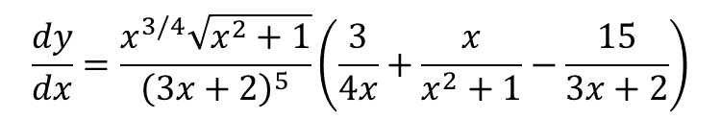


Example 4
Differentiate $y=\frac{x^{3/4}\sqrt{x^{2}+1}}{{\left(3x+2\right)}^{5}}$
Take logarithms of both sides of the equation and simplify
$$\ln{y=\frac{3}{4}\ln{x}+\frac{1}{2}\ln{(x^{2}+1)}}−5\ln{(3x+2)}$$
Differentiating implicitly with respect to x
$$\frac{1}{y}\frac{dy}{dx}=\frac{3}{4}\frac{1}{x}+\frac{1}{2}\frac{2x}{x^{2}+1}−5\frac{3}{3x+2}$$
Solving for dy/dx
$$\frac{dy}{dx}=y\left(\frac{3}{4x}+\frac{x}{x^{2}+1}−\frac{15}{3x+2}\right)$$
Substitute y and write
$$\frac{dy}{dx}=\frac{x^{3/4}\sqrt{x^{2}+1}}{{\left(3x+2\right)}^{5}}\left(\frac{3}{4x}+\frac{x}{x^{2}+1}−\frac{15}{3x+2}\right)$$

Slide 21

Exponents and Bases
Constant base
Constant exponent
Variable base
Constant exponent
Constant base
Variable exponent
Variable base
Variable exponent
To find $\frac{d}{dx}\left({\left[f\left(x\right)\right]}^{g\left(x\right)}\right)\text{logarithmic} \text{differentiation} \text{can} \text{be} \text{used}$

Slide 22

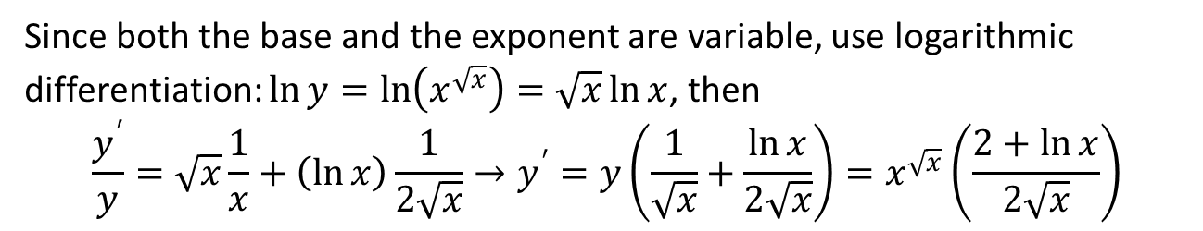
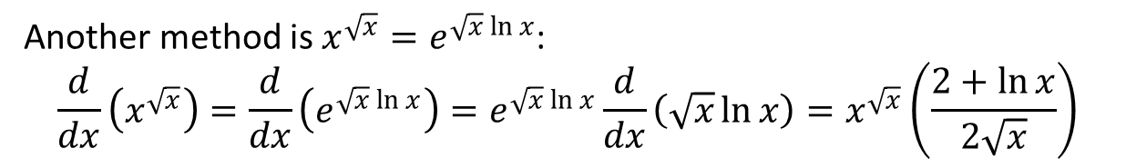
The Quotient Rule
Differentiate $y=x^{\sqrt{x}}$,
Solution 1
Since both the base and the exponent are variable, use logarithmic
differentiation: $\ln{y}=\ln\left(x^{\sqrt{x}}\right)=\sqrt{x}\ln{x}$, then
$$\frac{y^{′}}{y}=\sqrt{x}\frac{1}{x}+\left(\ln{x}\right)\frac{1}{2\sqrt{x}}→y^{′}=y\left(\frac{1}{\sqrt{x}}+\frac{\ln{x}}{2\sqrt{x}}\right)=x^{\sqrt{x}}\left(\frac{2+\ln{x}}{2\sqrt{x}}\right)$$
Solution 2
Another method is $x^{\sqrt{x}}=e^{\sqrt{x}\ln{x}}$:
$$\frac{d}{dx}\left(x^{\sqrt{x}}\right)=\frac{d}{dx}\left(e^{\sqrt{x}\ln{x}}\right)=e^{\sqrt{x}\ln{x}}\frac{d}{dx}\left(\sqrt{x}\ln{x}\right)=x^{\sqrt{x}}\left(\frac{2+\ln{x}}{2\sqrt{x}}\right)$$

Slide 23

$\frac{d}{dx}{\left[\ln{x}\right]}^{x}$=
$\frac{d}{dx}\left[x^{\frac{1}{x}}\right]=$

Slide 25
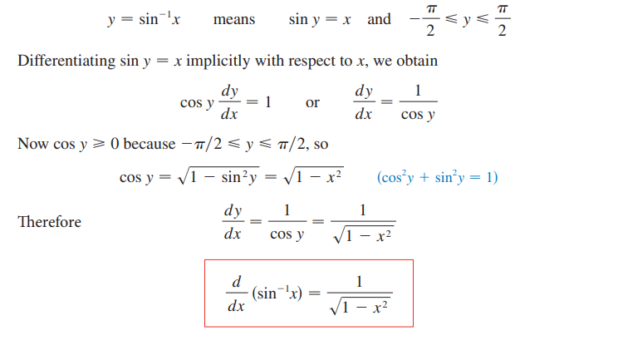
Derivatives of Inverse Trigonometric Functions

Slide 26
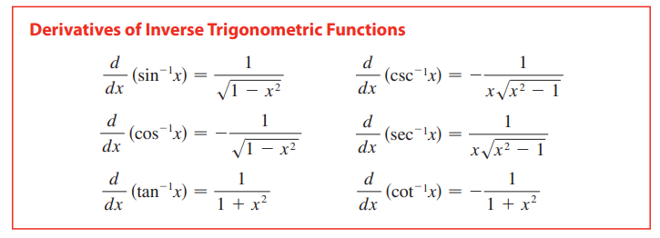
Derivatives of Inverse Trigonometric Functions

Slide 27


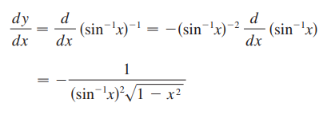
Derivatives of Inverse Trigonometric Functions

Slide 28
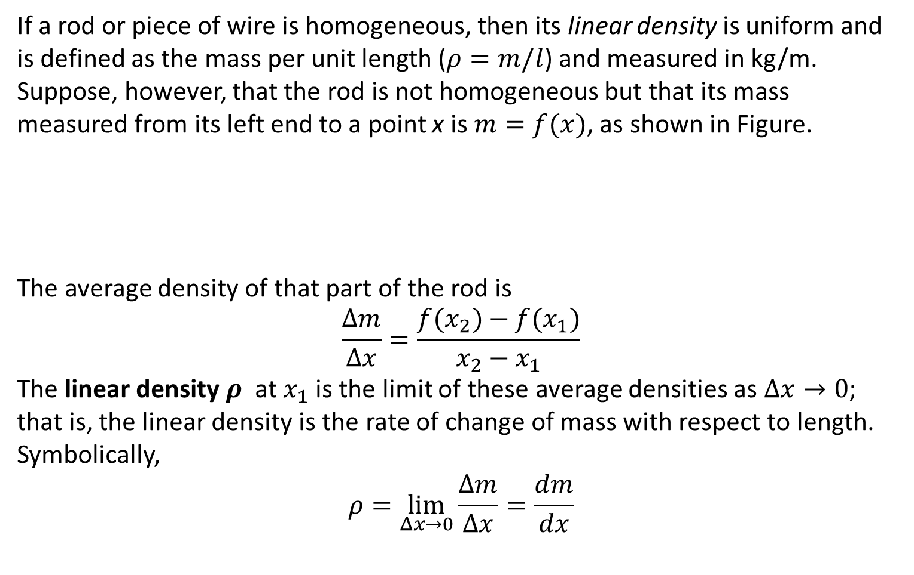
Example 5: Linear Density
If a rod or piece of wire is homogeneous, then its linear density is uniform and is defined as the mass per unit length ($ρ=m/l$) and measured in kg/m. Suppose, however, that the rod is not homogeneous but that its mass measured from its left end to a point x is $m=f(x)$, as shown in Figure.
The average density of that part of the rod is
$$\frac{Δm}{Δx}=\frac{f(x_{2})−{f(x}_{1})}{x_{2}−x_{1}}$$
The linear density $ρ$ at $x_{1}$ is the limit of these average densities as $Δx→0$; that is, the linear density is the rate of change of mass with respect to length. Symbolically,
$$ρ=\lim_{Δx→0}{\frac{Δm}{Δx}}=\frac{dm}{dx}$$

Slide 29
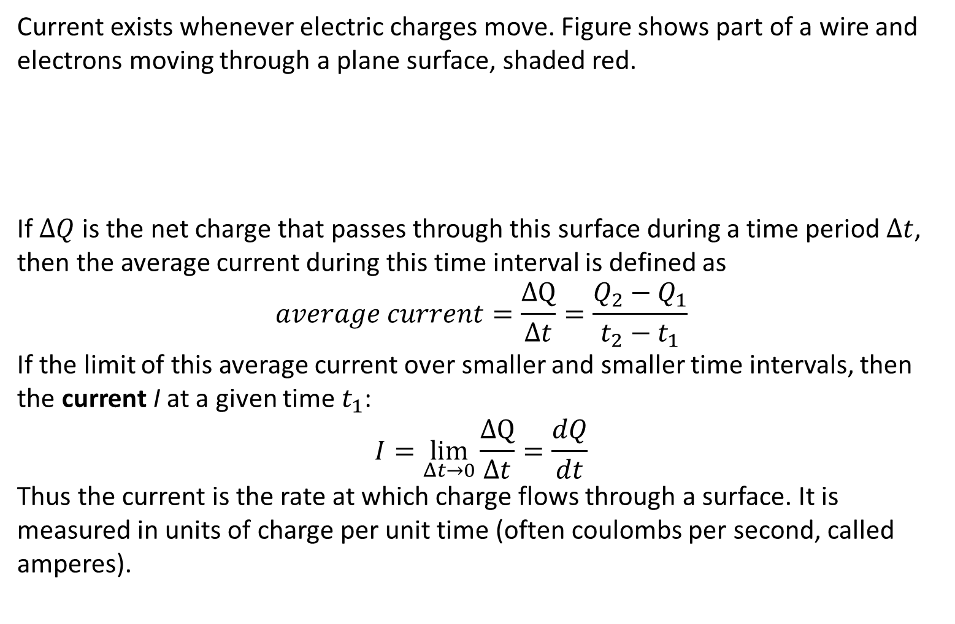
Example 6: Electric Charge
Current exists whenever electric charges move. Figure shows part of a wire and electrons moving through a plane surface, shaded red.
If $ΔQ$ is the net charge that passes through this surface during a time period $Δt$, then the average current during this time interval is defined as
$$average current=\frac{ΔQ}{Δt}=\frac{Q_{2}−Q_{1}}{t_{2}−t_{1}}$$
If the limit of this average current over smaller and smaller time intervals, then the current I at a given time $t_{1}$:
$$I=\lim_{Δt→0}{\frac{ΔQ}{Δt}}=\frac{dQ}{dt}$$
Thus the current is the rate at which charge flows through a surface. It is measured in units of charge per unit time (often coulombs per second, called amperes).

Slide 30
Related Rates Problem
1
Read the problem carefully.
2
Draw a diagram if possible.
3
Introduce notation. Assign symbols to all quantities that are functions of time.
4
Express the given information and the required rate in terms of derivatives.
5
Write an equation that relates the various quantities of the problem.
6
Use the Chain Rule to differentiate both sides of the equation with respect to t.
7
Substitute the given information into the resulting equation and solve for the unknown rate.

Slide 31
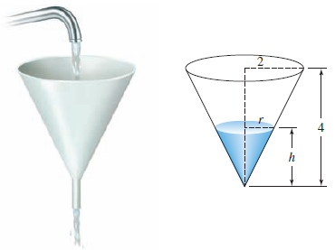
Example 7 (1/3)
Water is poured into a conical funnel at the constant rate of 1 in.³/sec and flows out at the rate of 0.5 in.³/sec. The funnel is a right circular cone with a height of 4 in. and a radius of 2 in. at the base.
How fast is the water level changing when the water is 2 in. high?

Slide 32
Example 7 (2/3)
Step 1
Let
V = the volume of the water
Step 2
We are given that
Step 3
The volume of water in the funnel is
$$V=\frac{1}{3}πr^{2}h$$
using similar triangles
$$\frac{r}{h}=\frac{2}{4} \text{or} r=\frac{h}{2}$$
we obtain
$$V=\frac{1}{12}πh^{3}$$
The volume of water in the funnel is
𝑉=1/3 𝜋𝑟^2 ℎ
using similar triangles
𝑟/ℎ=2/4 " or " 𝑟=ℎ/2
we obtain
𝑉=1/12 𝜋ℎ^3
h = the height of the water
r = the radius of the surface of the water
$$\frac{dV}{dt}=1−\frac{1}{2}=\frac{1}{2}$$
𝑑𝑉/𝑑𝑡=1−1/2=1/2
and are asked to find dh/dt when
h = 2

Slide 33
Example 7 (3/3)
Step 4
Differentiating this last equation implicitly with respect to t, we obtain
$$\frac{dV}{dt}=\frac{1}{4}πh^{2}\frac{dh}{dt}$$
Differentiating this last equation implicitly with respect to t, we obtain
𝑑𝑉/𝑑𝑡=1/4 𝜋ℎ^2 𝑑ℎ/𝑑𝑡
Step 5
Finally, substituting dV/dt = ½ and h = 2 into this equation gives
$$\frac{dh}{dt}=\frac{1}{2π}≈0.159$$
and we see that the water level is rising at the rate of 0.159 in./sec.
Finally, substituting dV/dt = ½ and h = 2 into this equation gives
𝑑ℎ/𝑑𝑡=1/2𝜋≈0.159
and we see that the water level is rising at the rate of 0.159 in./sec.

Slide 34
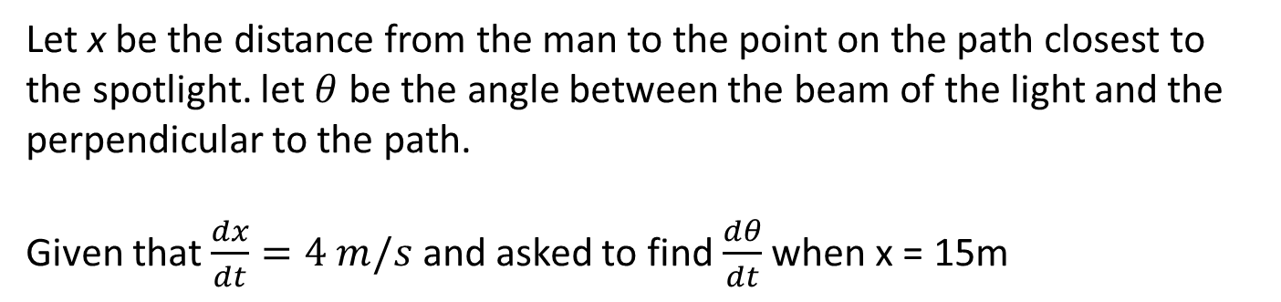
Example 8 (1/2)
A man walks along a straight path at a speed of 4 ft/s. A spotlight is located on the ground 20 ft from the path and is kept focused on the man. At what
rate is the spotlight rotating when the man is 15 ft from the point on the path closest to the light?
Let x be the distance from the man to the point on the path closest to the spotlight. let $θ$ be the angle between the beam of the light and the perpendicular to the path.
Given that $\frac{dx}{dt}=4 m/s$ and asked to find $\frac{dθ}{dt}$ when x = 15m

Slide 35
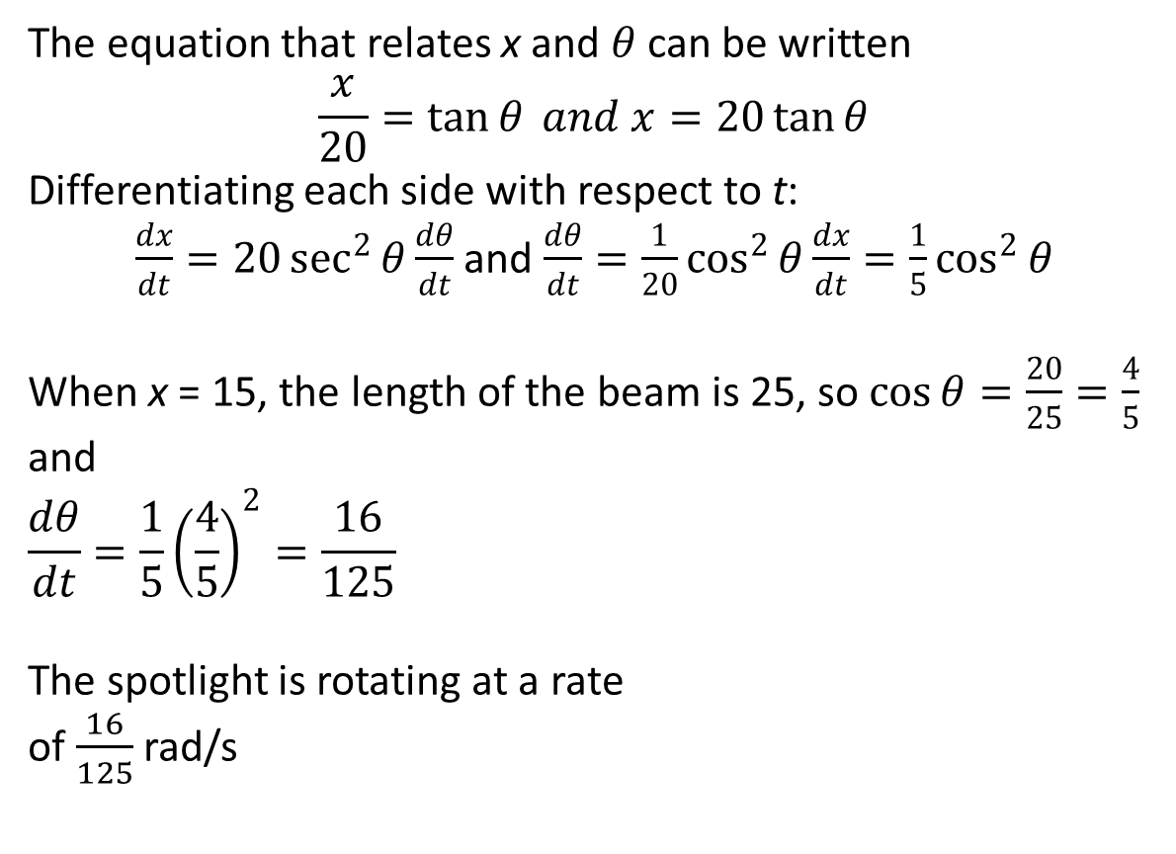
Example 8 (2/2)
The equation that relates x and $θ$ can be written
$$\frac{x}{20}=\tan{θ} and x=20\tan{θ}$$
Differentiating each side with respect to t:
$\frac{dx}{dt}=20\sec^{2}{θ}\frac{dθ}{dt}$ and $\frac{dθ}{dt}=\frac{1}{20}\cos^{2}{θ\frac{dx}{dt}}=\frac{1}{5}\cos^{2}{θ}$
When x = 15, the length of the beam is 25, so $\cos{θ}=\frac{20}{25}=\frac{4}{5}$
and
$$\frac{dθ}{dt}=\frac{1}{5}{\left(\frac{4}{5}\right)}^{2}=\frac{16}{125}$$
The spotlight is rotating at a rate
of $\frac{16}{125}$ rad/s

Slide 36
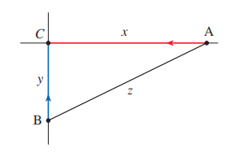
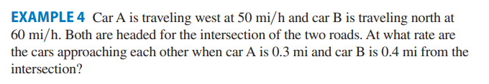

Slide 37
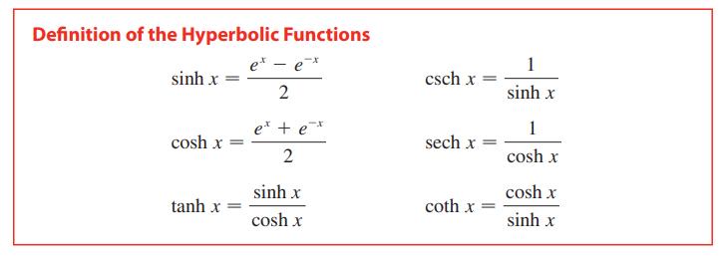
Hyperbolic Functions

Slide 38
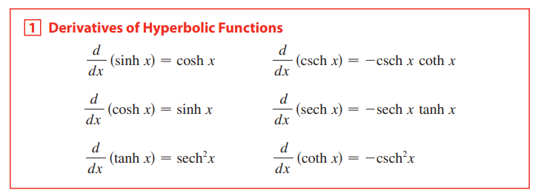
Derivatives of Hyperbolic Functions

Slide 39
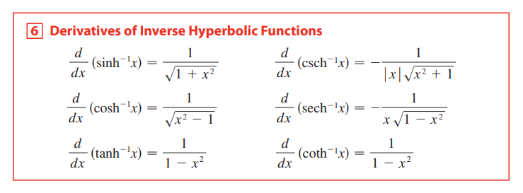
Derivatives of Inverse Hyperbolic Functions

Slide 40
Thank You

